Slide 1
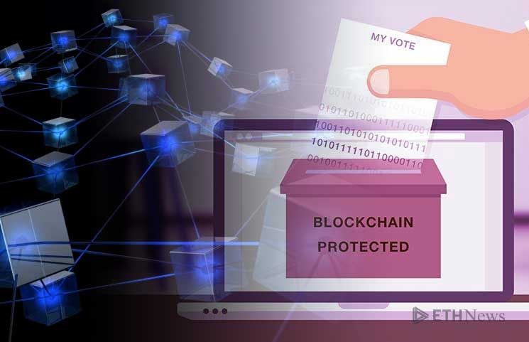
Blockchain for Voting & Elections
Course: Blockchain & its Application
Submitted by: Group No.1
Members:
Piyush Datir, Aniket Pawar, Aditya Joshi
Aditya Dorwekar

Slide 2
Introduction
In every democracy, the security of an election is a matter of national security. In many undeveloped countries, there is a high percentage of corruption in their governments, making the traditional election processes very unreliable and not trustworthy. Today's systems can only be accessed by the entity in charge of the election process and can be very easy to manipulate and modify data. This is where the voters' loss of confidence in the system arises. Blockchain can help to implement an electronic voting system that is immutable, transparent and cannot be hacked into in order to change the result. blockchain voting is an effective means to conduct fair elections.

Slide 3
the problem will be reduced with Blockchain, when every person can access real-time information without changing any information. The vote centre will be the only ones who will have access to writing data but will not delete or change after the information has been written to the Blockchain database. Also, using this kind of database, there is a lot of information that they can obtain for each record, like in what voting centre and for what candidate is the vote, but this will depend on the design and architecture of the solution being made.
Blockchain enables a smart, secure, and efficient election system. The technology encompasses almost all aspects of an election, from registration of voters to verification of voter identity, ballot casting, and vote counting. In blockchains, the information is stored in a chain of ordered blocks validated by network participants.

Slide 4

How will Blockchain Enhance Election Outcomes
Increased voter accessibility
Blockchain is immutable to cyber-attacks and will provide a secure system if the vote is properly inputted.
Enhanced vendor security Electronic transmission without interference will ensure all votes are submitted on time and are counted by the deadline. A predetermined ballot structure with software that prevents voter error when filling out a ballot will be employed, hence decreasing ballot invalidation chances.
Blockchain technology in elections will provide a sense of security and mitigate vote manipulation fears, thus enhancing voter confidence.
Improve voter privacy.
Cut down on high election costs.

Slide 5
High Level Blockchain Design Features
Type of Blockchain can be used in The Blockchain Based Voting
In our proposal, we will use a permissioned blockchain, a variation of the consortium-based chains, which uses the proof-of-authority (POA) consensus algorithm.

Slide 6
Tokenization.
Voters can be rewarded for voting with tokens when they cast their vote in an election in the near future, which could be integrated with a smart city project.

Slide 7
Transactions in the system
Each vote is stored as a transaction on the blockchain and each voter receives the transaction ID for their vote for verifying purposes. Each vote is appended onto the blockchain by its corresponding ballot smart contract. The network is appended only if all corresponding district nodes agree on the verification of the vote data.

Slide 8
Smart Contract
We implement our e-voting system, as a system based on a smart contract in a permissioned blockchain.
Defining a smart contract includes identifying the roles that are involved in the agreement (the election agreement in our case) and the different components and transactions in the agreement process.
Each vote is added into the blockchain by its corresponding ballot smart contract

Slide 9
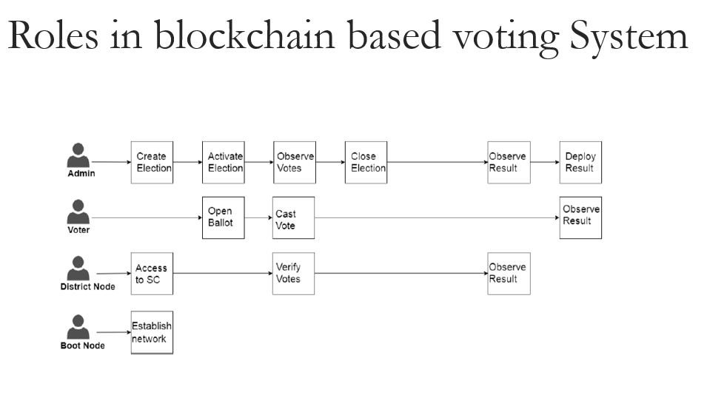
Blockchain network design & The roles interacting with the blockchain
Election administrators
Voters
District nodes
Boot nodes

Slide 10
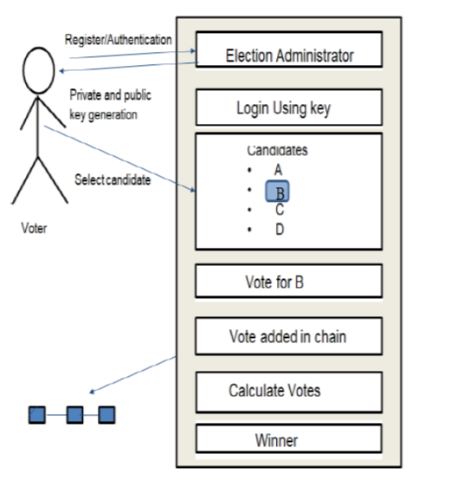
Block Design:

Slide 11
Steps of the Electoral Process
Election creation.
The election administrators conduct voter registration- Registration of voters.
Vote transaction.
Results Tallying.
Vote Verification.

Slide 12
Conclusion:
To make the public electoral process cheaper, faster and easier, is a compelling one in modern society.
It will removes a certain power barrier between the voter and the elected official.
It also opens the door for a more direct form of democracy, allowing voters to express their will on individual bills and propositions.

Slide 13
Besides the use of blockchain in payments and cryptocurrencies, the technology’s use has been advocated for storing information regarding tangible assets such as land and education records to ensure against frauds
The Election Commission of India is working with IIT-Madras for using blockchain technology to enable app-based e-voting to make the process more convenient
Indian Election commission is doing a project with IIT-Madras, Chennai, and some of the eminent scientists. To implement the blockchain based voting in reality they are very hopeful by the 2024 Lok Sabha elections we can see a lot of fundamental differences in the way.

Slide 14
Blockchain based voting start-ups
CommitCoin
BitCongress

Slide 15
References:
https://www.ibm.com/topics/what-is-blockchain
https://imiblockchain.com/real-world-uses-of-blockchain-in-2020/
https://www.crunchbase.com/organization/follow-my-vote-inc
www.researchgate.net
http://qnimate.com/blockchain-based-identity-records-management-and-voting-using-aws/
https://link.springer.com/chapter/10.1007/978-3-030-02351-5_45
https://www.economist.com/
https://www.scientificamerican.com/article/are-blockchains-the-answer-for-secure-elections-probably-not/
www.medium.com

Slide 16
Thank You.

